Slide 1
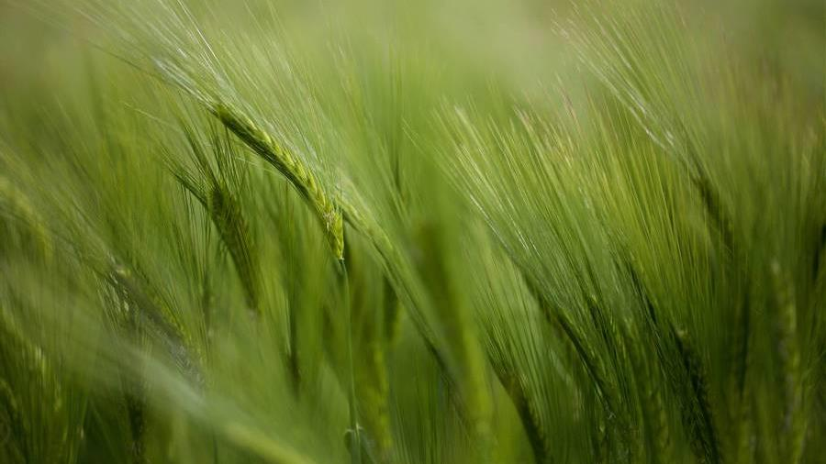
RICE GRAIN CLASSIFICATION AND ANALYSIS FOR QUALITY ASSURANCE
By : Lavanya Mogulla(VX87176)
Professor : Chaojie Wang

Slide 2
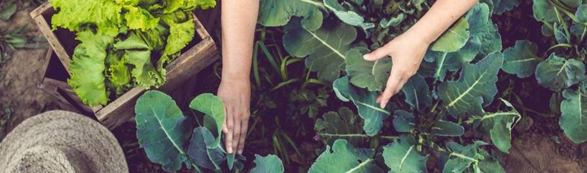
INTRODUCTION
Rice is an edible starchy cereal grain and the grass plant by which it is produced. Roughly one-half of the world population, including all East and Southeast Asia, is wholly dependent upon rice as a staple food.
There are over 40,000 varieties of rice on the planet. We are going to assess 5 of these grains in this project.
This project represents a technological leap in agricultural quality control, utilizing advanced image processing and machine learning to automate the classification and assessment of rice grains.
This integration of technology in agriculture not only enhances efficiency and accuracy in food quality assessment but also sets a new standard in the agri-food industry.

Slide 3
Research Questions
What are the most critical features in the dataset for accurately classifying rice grain quality, and how do these features correlate with visual characteristics observed in the image dataset?
How can the model contribute to sustainable rice production by reducing resource wastage and optimizing production processes?
What kind of detailed reports and statistics on rice quality can the model provide, and how can these be effectively utilized for quality assurance and compliance with industry standards?

Slide 4
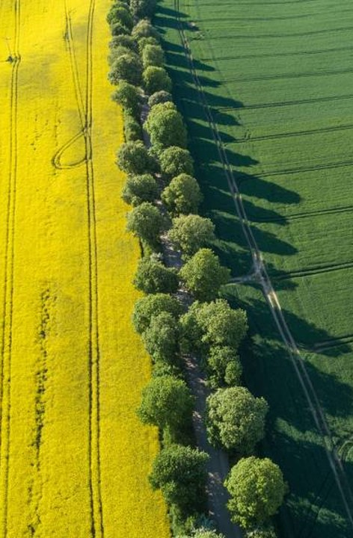
Data Source
The data for this project is collected from Kaggle.
The size of the data is 267.35MB
Number of images are 75k
There are 5 types of rice. Each class has equal data of 15k images.

Slide 5
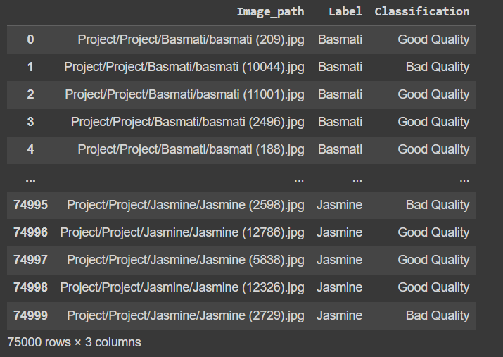
Data PRE-PROCESSING
Optimized dataset selection
Due to limitations in GPU resources, a decision was made to utilize a dataset comprising 6,000 images for each class.
This approach was adopted to ensure efficient processing and analysis within the available computational constraints.
ENHANCING VALUE WITH QUALITY ASSESSMENT
In extending the scope of this project beyond mere rice classification, we've incorporated a crucial element of quality assessment to offer a more comprehensive and practical analysis of rice varieties.

Slide 6
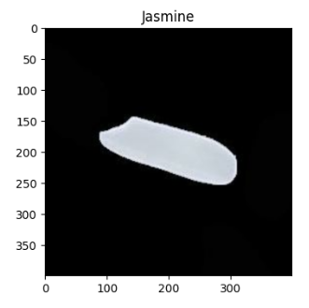
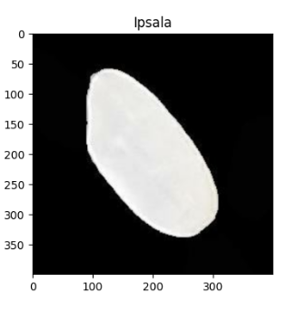
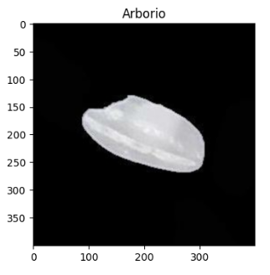
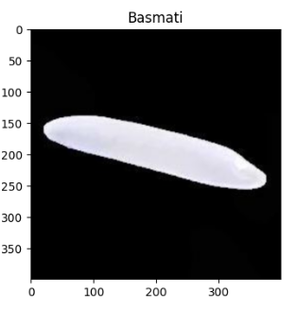
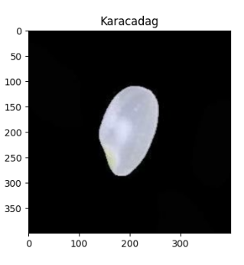
Samples of rice

Slide 7
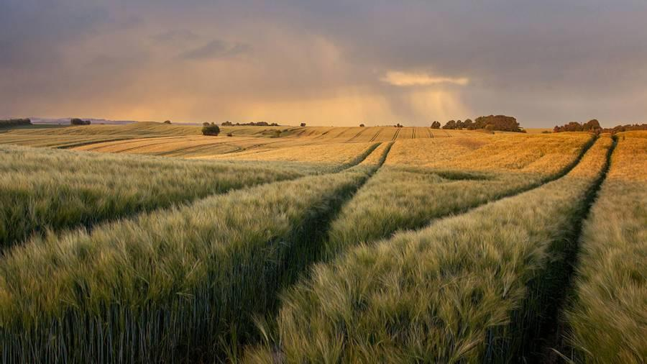
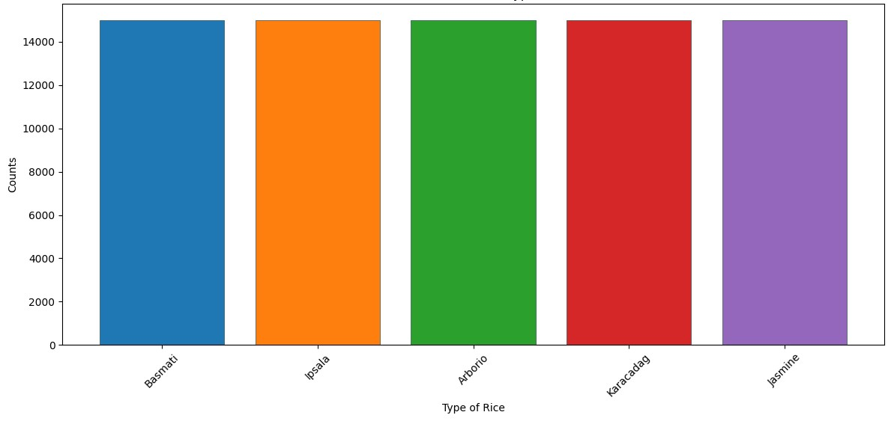
Data Visualization
Distribution of different types of rice

Slide 8
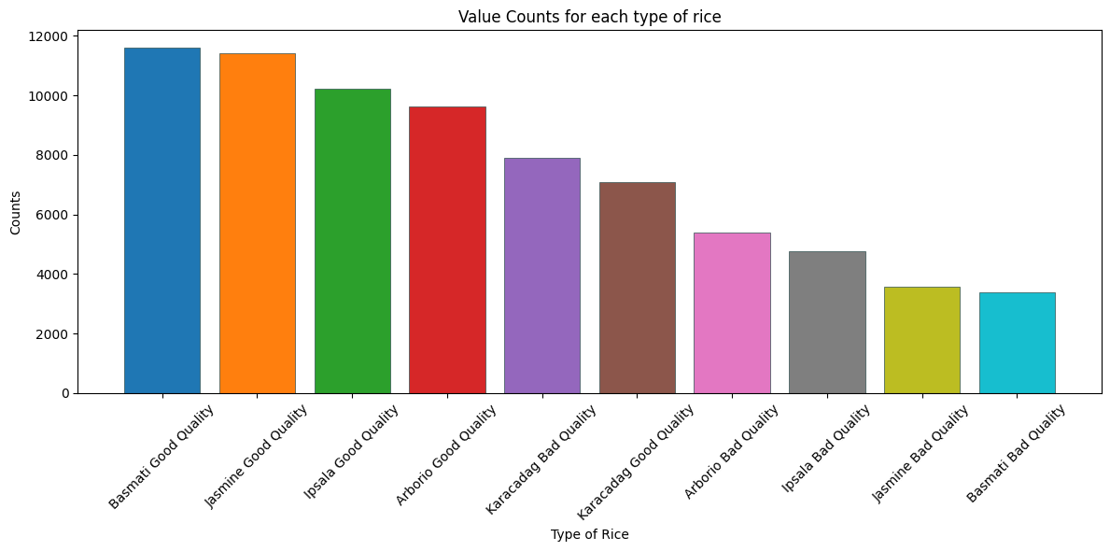

Slide 9
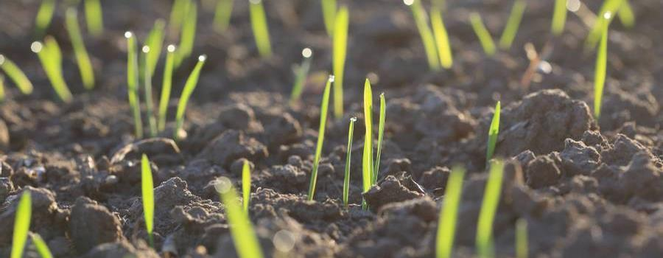
TensorFlow Image Classification Pipeline
Data preparation
Data Augmentation
The dataset underwent various random augmentations such as flipping, and modifications to hue, saturation, brightness, and contrast to enhance model robustness and data variability.
The dataset was partitioned into training and testing subsets with a 33% test size allocation, and image labels were numerically encoded and assigned across both sets.
TENSOR FLOW DATA GENERATORS
IMAGE LOADING AND PRE-PROCESSING
A custom load_image function was implemented to read and decode JPEG images, complemented by a preprocess_image function that resizes, normalizes images, and applies one-hot encoding to the labels.
tfdata_generator function to create efficient data pipelines.
DATASET HANDLING
Batch size set to 32 for manageable memory usage and generators are separated for training and testing datasets

Slide 10

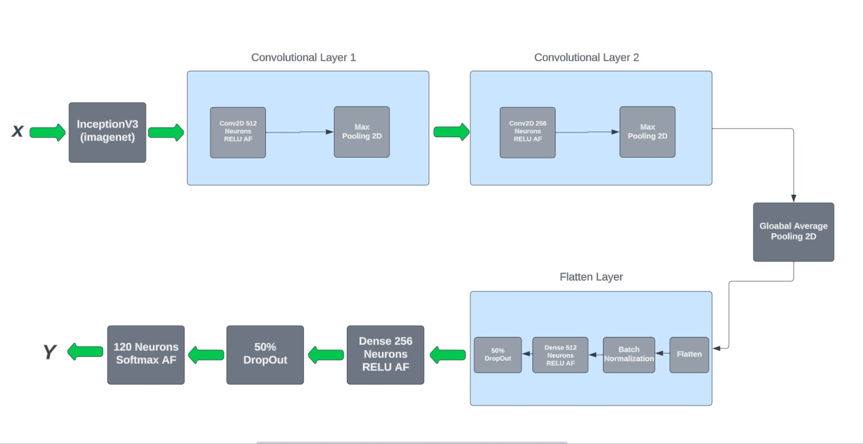
Model architecture
abstract
We believe people need more products specifically dedicated to this niche market​
design
Minimalist and easy to use ​

Slide 11
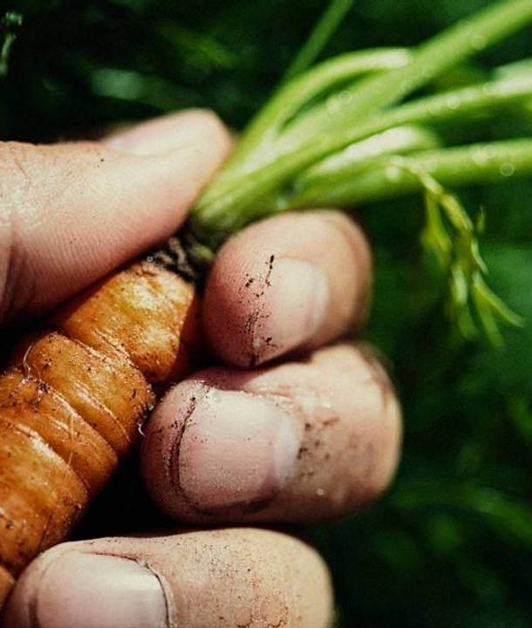
INCEPTION V3
Input LAYER​
Receives images with shape (400,400,3)
Pre-trained on imageNet and extracts complex features from input images​
INCEPTION V3 BASE
CONV2D LAYERS
Apply convolution operations to extract high-level features and kernel regularizer (L2) helps in reducing overfitting
MAX POOLING 2D LAYERS
Reduce spatial dimensions, focusing on important features.​

Slide 12

INCEPTION V3 (CONT.)
GLOBal average pooling 2d
Flatten layer
Dense layer
Output layer
Reduces each feature map to a single average value, decreasing model complexity and computations
Converts pooled feature maps into a single vector, preparing for fully connected layers.
Fully connected layers learn non-linear combinations of high-level features.
Final layer with softmax activation for multi-class classification.

Slide 13
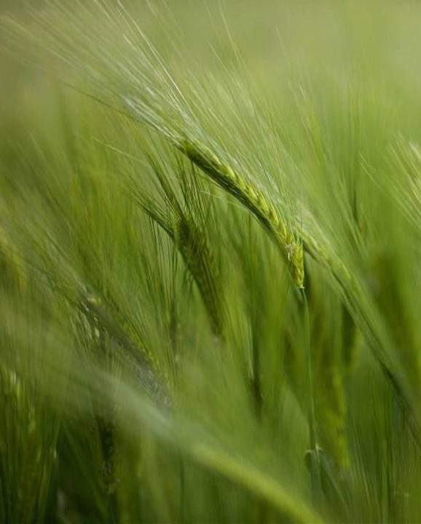
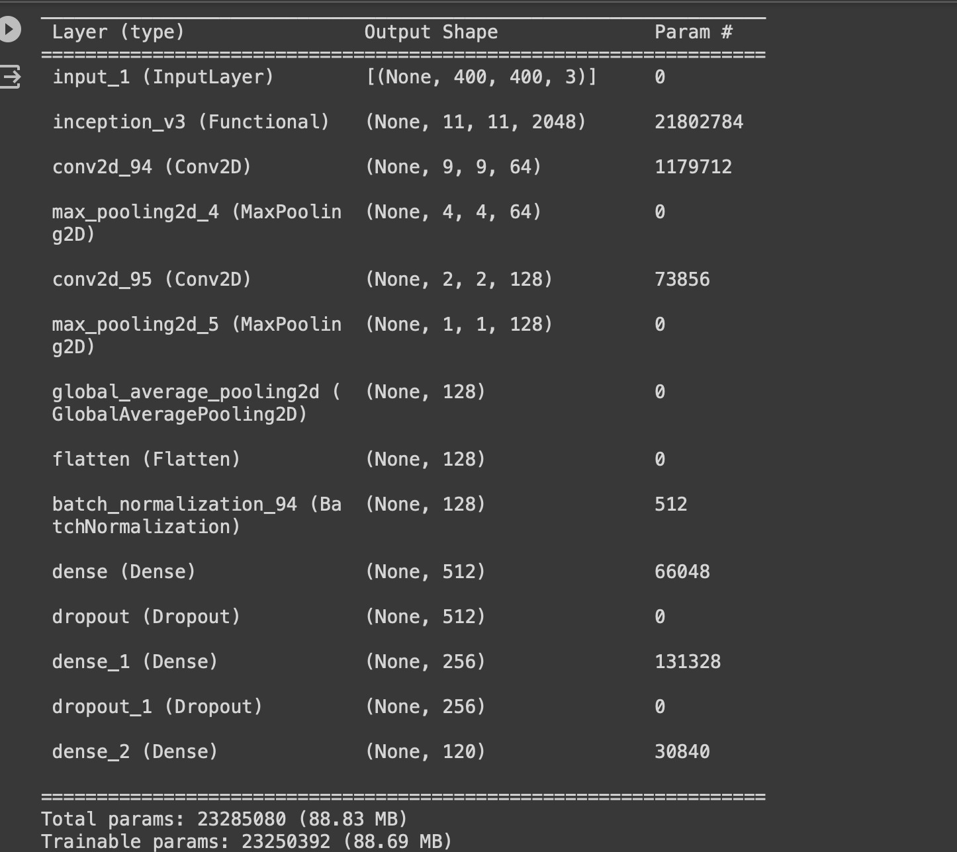
How we’ll scale in the future​
Feb 20xx
Roll out product to local farms in the region to help establish the product​
May 20xx
Release the product to the general public and monitor press and regional market trends​
Oct 20xx
Gather feedback from the agriculture and farming community to expand availability of the product​

Slide 14
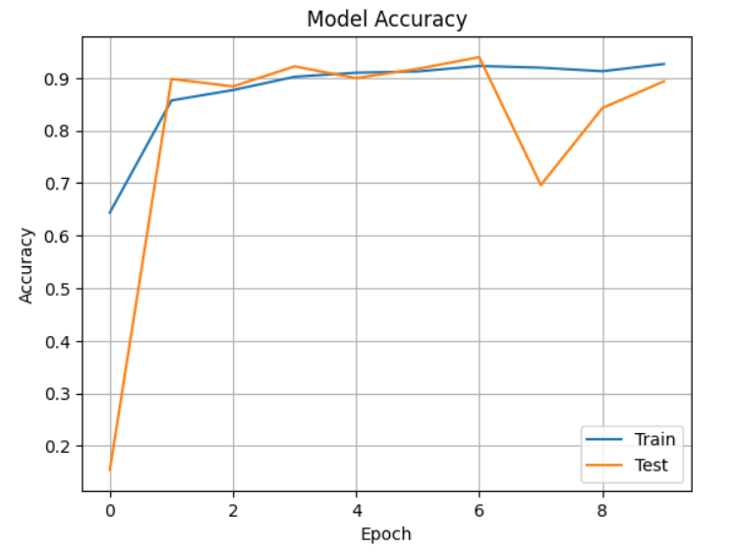
ACCURACY V/S EPOCH PLOT
Expensive​
affordable

Slide 15
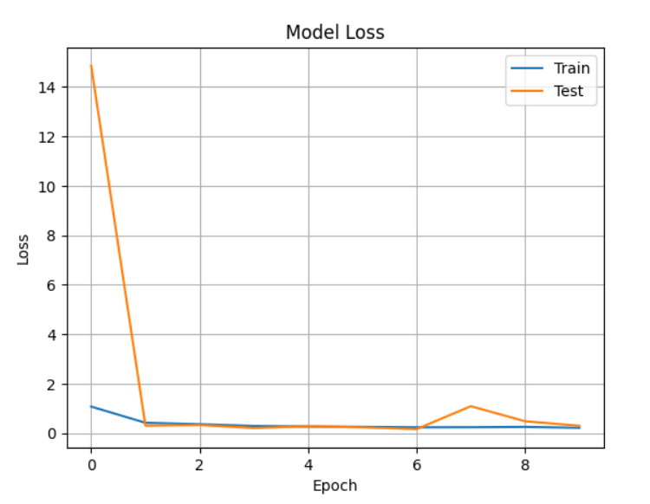
LOSS V/S EPOCH PLOT
Expensive​
affordable

Slide 16
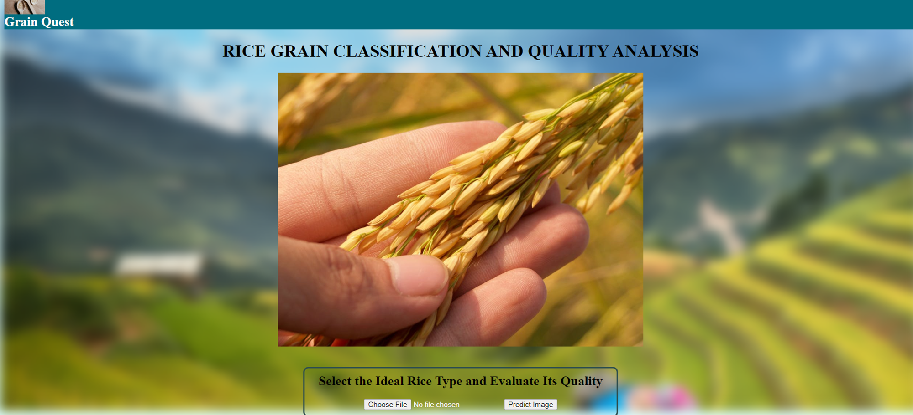
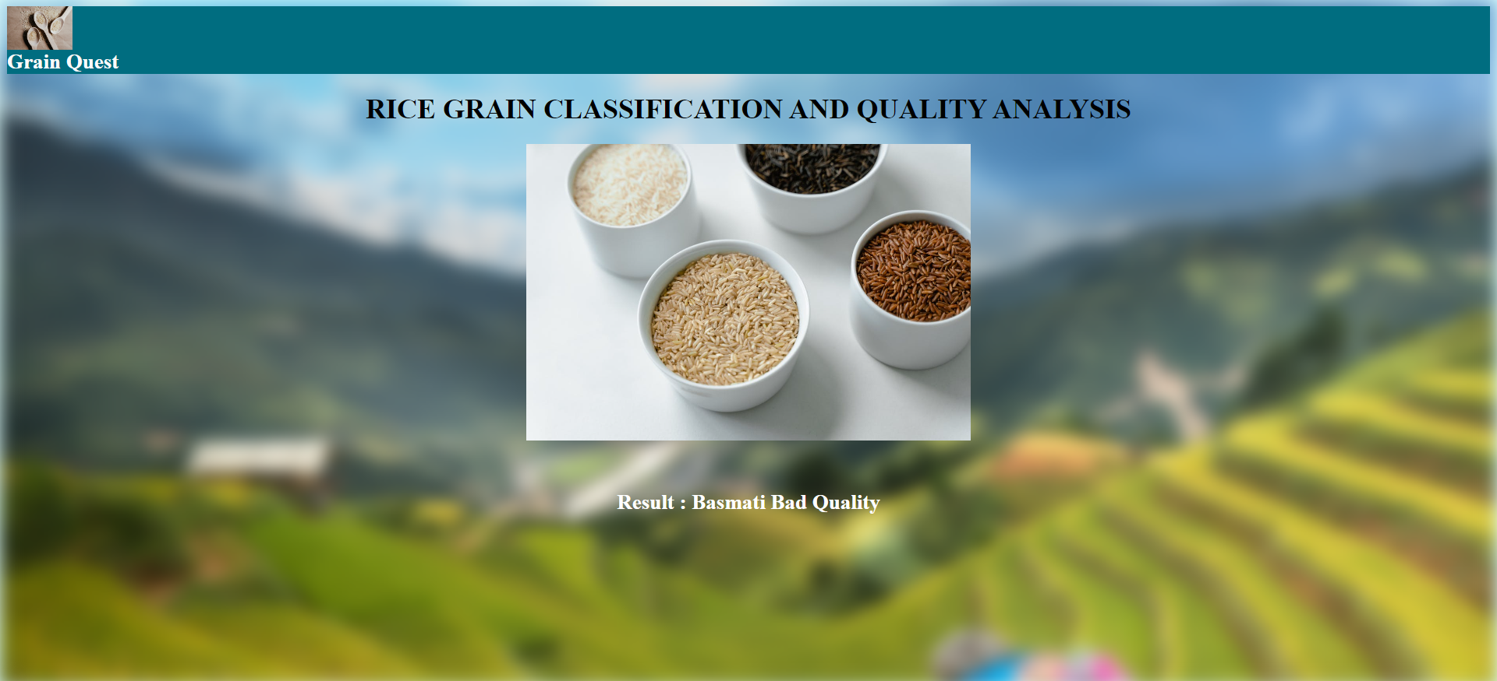
WEB APPLICATION

Slide 17
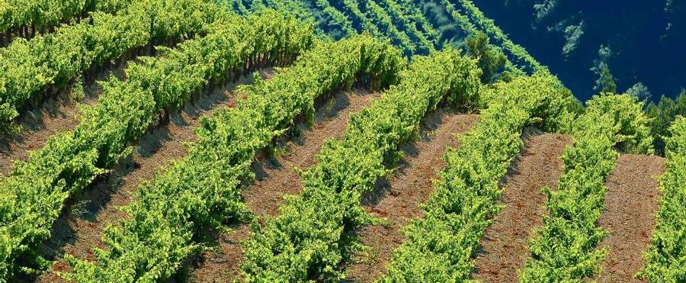
conclusion
This project marks a significant advancement in agri-tech by leveraging machine learning to accurately classify rice varieties and assess quality. This innovation offers a scalable alternative to manual inspection, enhancing efficiency and precision in agricultural practices and food quality control. The project's success paves the way for future technological integration into the agricultural sector, promising improved standards and food security.

Slide 18

Thank you

